Slide 1
Reinforcement Learning 2024/25 WS Final Project Presentation
Emre Güçer

Slide 2
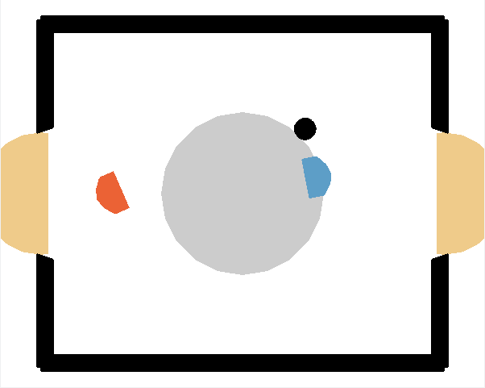
Task Description
Create a Reinforcement Learning agent to play air hockey
Create an algorithm from scratch or make modifications to an existing one.

Slide 3
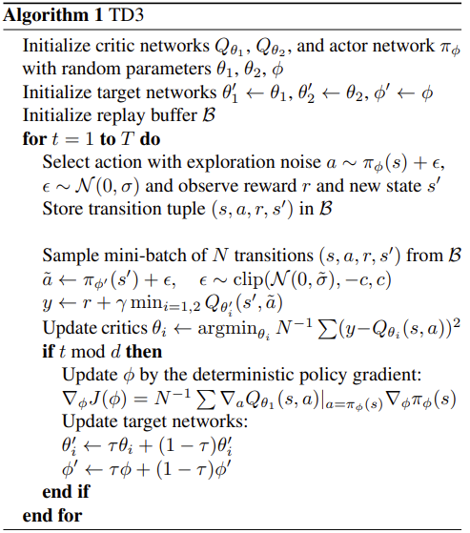
Chosen Base Algorithm: TD3
An improved version of DDPG
DDPG uses one Q-Function => overestimation bias
Solution: Use two Q-Function
My code and TD3 algorithm are based on “Addressing Function Approximation Error in Actor-Critic Methods” research paper written by Scott Fujimoto, Herke van Hoof and David Meger

Slide 4
Changes I made to TD3 Algorithm
LeakyReLU Instead of ReLU
Prevents dead gradients for negative inputs
Normalization of Layers
Enhances stability of training
He Initialization for Better Weight Distribution
Minimizes vanishing and exploding gradients
Weight Decay in Adam Optimizer
Prevents overfitting
Gradient Clipping
Prevents exploding gradients
Usage of Torch Tensors for GPU Optimization
Increases speed of processing
Not Having Explicit Save and Load Methods
These were moved to training file; therefore, no impact

Slide 5
Methodology of Training and Evaluation
Get parameters from user
If exists, load existing best agent and observed transitions
Start training the agent using given parameter settings
On every promising episode (or check point), evaluate quality of episode
If results would be better than older one, replace the best agent with the new one
At every 5 iterations save memory so that script can refer to saved episodes

Slide 6
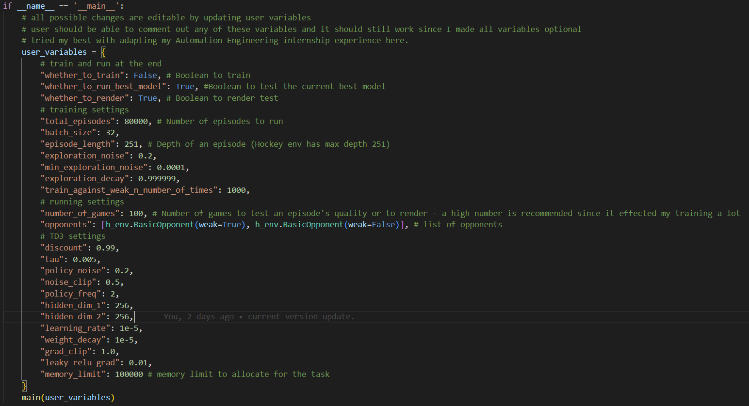
Customizability of the Training Pipeline

Slide 7
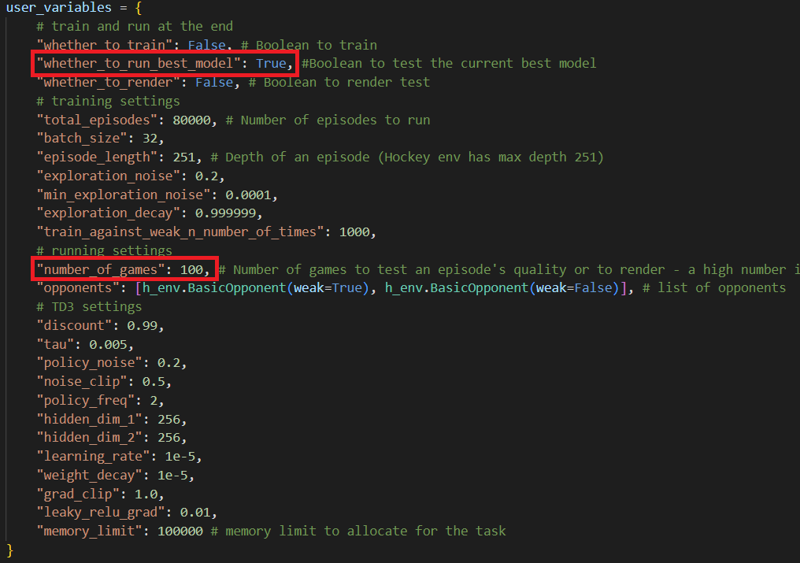
Performance Against the Basic Opponents
Played 100 games against both agents:
Test against weak opponent
Test against strong opponent

Slide 8
Testing Against Weak Opponent
• Agent success (Number of games with positive reward) count: 29
• Average reward: -5.43
• Success rate (Percentage of games with positive reward): 29.0%

Slide 9
Testing Against Strong Opponent
• Agent success (Number of games with positive reward) count: 23
• Average reward: -6.95
• Success rate (Percentage of games with positive reward): 23.0%

Slide 10
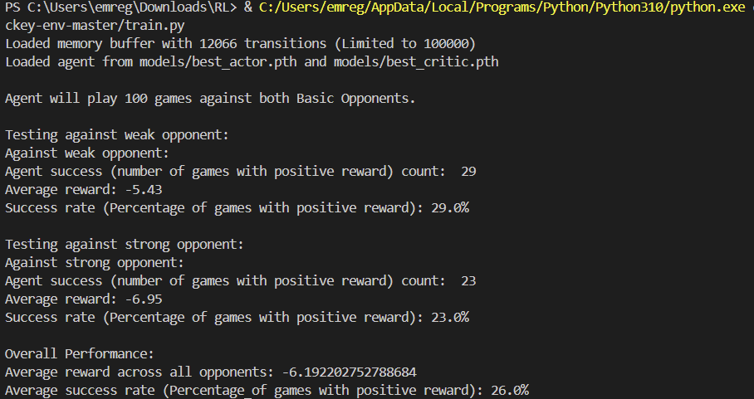
Overall Performance
• Average reward across all opponents: -6.19
• Average success rate (Percentage of games with positive reward): 26.0%

Slide 11
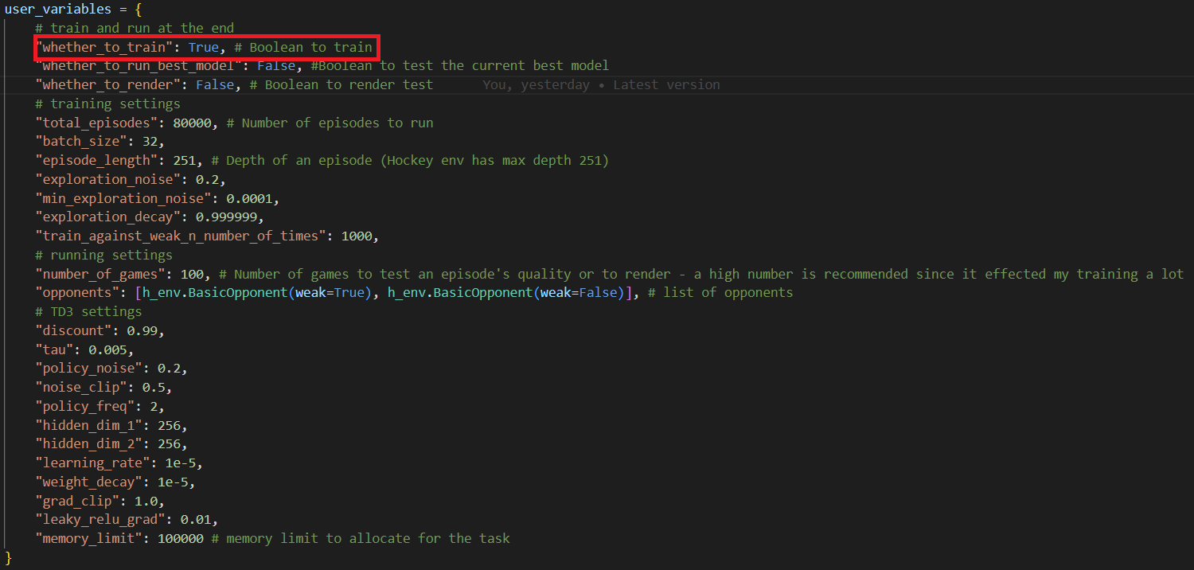
How to Train

Slide 12
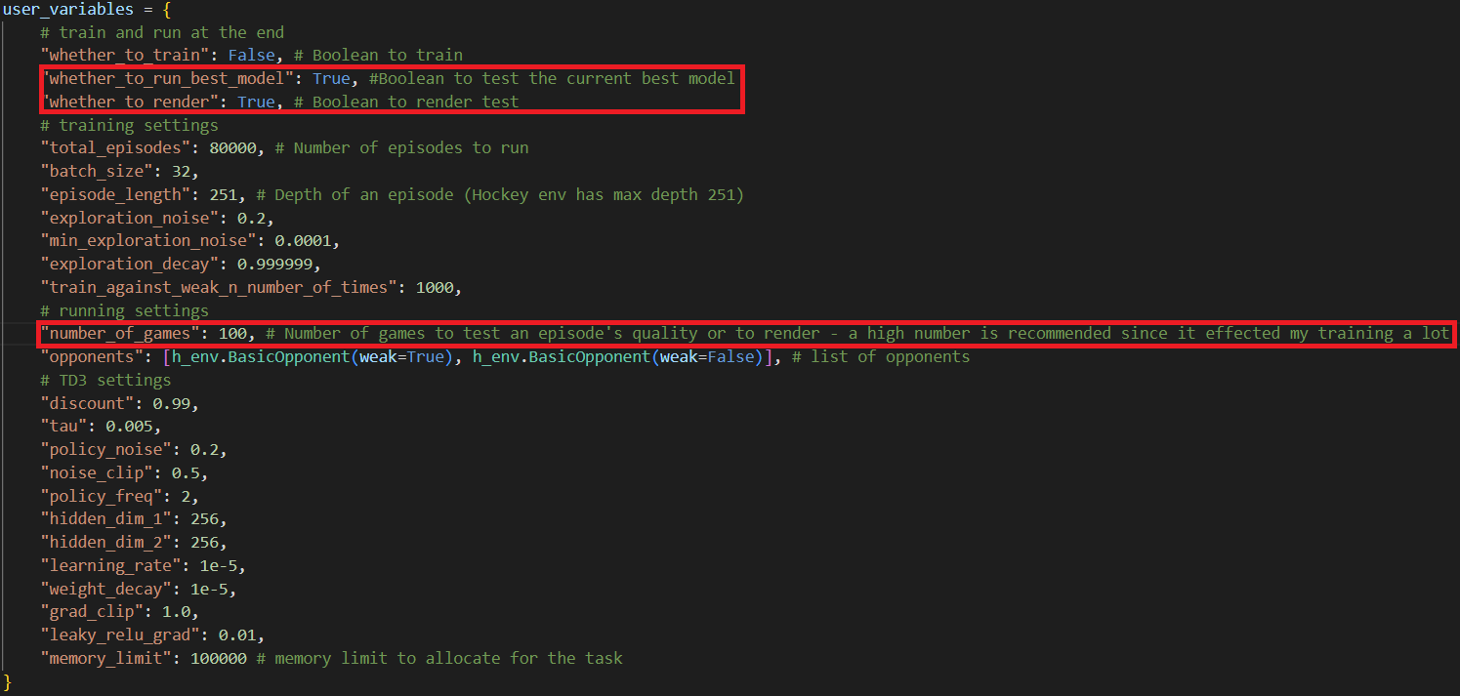
How to Watch Games

Slide 13
Demo: Recorded Games

Slide 14
Future Improvements
Forcing some parameters (especially number times an episode gets evaluated for this project) to have certain bounds.

Slide 15
Repo Link
https://github.com/gucere/RL

Slide 16
Thank You for Listening

